Slide 1
ADVENTURE WORKS CYCLE
ANALYTICS
GROUP 3

Slide 2
CONTENTS:
Introduction
KPI’s
Dashboards
SQL Queries
Conclusion

Slide 3
INTRODUCTION: Adventure Works Cycles is a fictional company designed to provide a practical framework for exploring data analytics and business intelligence solutions. As a simulated global manufacturer and retailer of bicycles and cycling equipment, the company embodies a diverse and dynamic business model that reflects the complexities of real-world operations. This makes it an ideal platform for studying and applying analytics techniques. At the heart of Adventure Works' analytics is its robust and well-structured database, which captures data across key domains such as sales, production, inventory, purchasing, and human resources. Each dataset is interconnected, simulating how modern organizations manage and analyze data to make informed decisions.

Slide 4
The Adventure Works Cycle project involved working with a comprehensive dataset to analyze and derive actionable insights into sales performance. My key responsibilities included: Data Preparation: I appended data from multiple sources, applied lookup functions to enrich datasets, utilized date functions for time-based insights, and cleaned the data to ensure consistency and accuracy. Data Analysis: I created a Pivot Table to facilitate detailed analysis and visual representation of trends. The analysis spanned across multiple dimensions like year, month, and quarter.

Slide 5
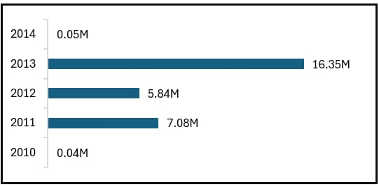
KPI 1 Year wise sales The diagram is a horizontal bar chart comparing data over the years from 2010 to 2014. Each bar represents a specific year's value in millions (M), with the exact values labeled at the end of each bar. Here's an analysis of the chart: 2010 and 2014: These years have minimal values of 0.04M and 0.05M, respectively, indicating very low activity or output compared to other years. 2011 and 2012: These years show moderate performance: 2011 has a value of 7.08M. 2012 has a slightly lower value at 5.84M. 2013: This is the standout year with a value of 16.35M, significantly higher than any other year, suggesting peak performance or activity.

Slide 6
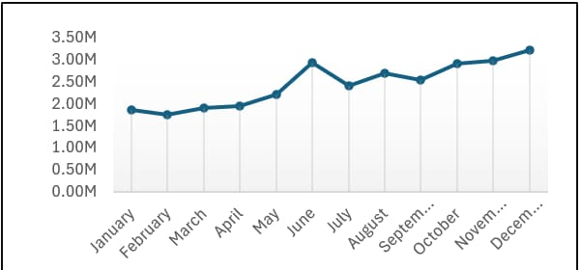
KPI 1 Month wise sales The diagram is a line chart that tracks a metric over the months of a year, with the values measured in millions (M). Here’s an explanation of the data trends in the chart: General Trend: The metric starts relatively low in January and shows gradual growth as the months progress. A peak occurs in June, reaching the highest value of the year, at just above 3M. After the June peak, the values decline slightly in July, stabilize through August and September, and then begin a steady increase from October to December. Key Observations: Flat Start: The values in the first few months (January to April) remain relatively steady, suggesting slow growth or consistent performance. Mid-Year Peak: June represents a high point in activity or performance, which could indicate seasonality or a mid-year boost in operations. End-of-Year Growth: The steady rise from October to December suggests increasing activity, likely driven by end-of-year factors such as holiday demand or seasonal trends.

Slide 7
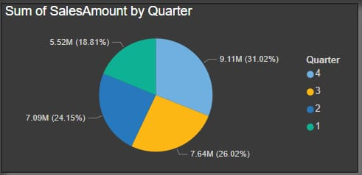
KPI 3 Quarter wise sales The diagram is a pie chart that represents the Sum of Sales Amount by Quarter. Each slice of the pie corresponds to one of the four quarters in a year, with the percentage share and absolute sales amount (in millions) indicated for each. Breakdown of the Data Q4 (Light Blue): Sales: 9.11M Percentage: 31.02% Q4 has the highest contribution, suggesting strong performance during the last quarter, likely influenced by holiday sales or year-end purchases. Q3 (Yellow): Sales: 7.64M Percentage: 26.02% Q3 also performs well, indicating consistent demand during this period. Q2 (Dark Blue): Sales: 7.09M Percentage: 24.15% Q2 shows steady sales, contributing slightly less than Q3. Q1 (Green): Sales: 5.52M Percentage: 18.81% Q1 has the lowest sales contribution, which could reflect slower activity at the start of the year. This chart highlights that most of the sales activity is concentrated in the latter half of the year, with Q4 leading significantly. The data suggests potential seasonality, where strategic planning for marketing and production efforts should focus on the second half, particularly Q4, to maximize revenue.

Slide 8
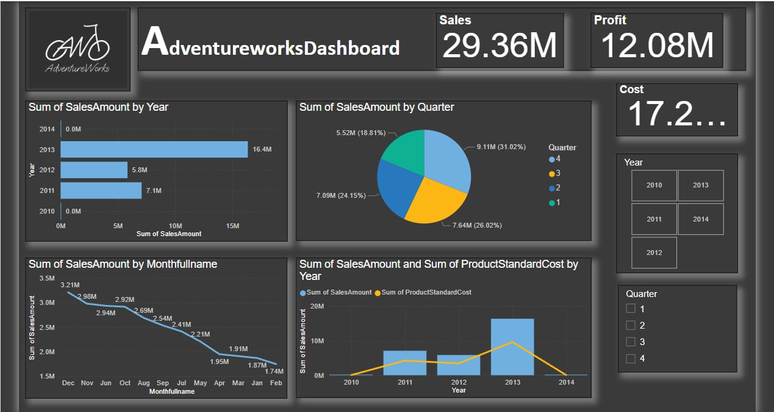
DASHBOARDS PowerBI Dashboard:

Slide 9
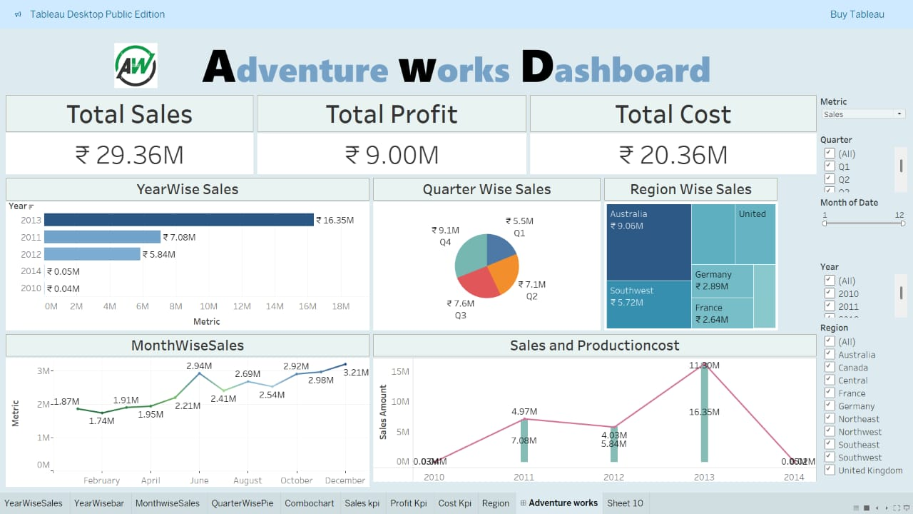
Tableau Dashboard:

Slide 10
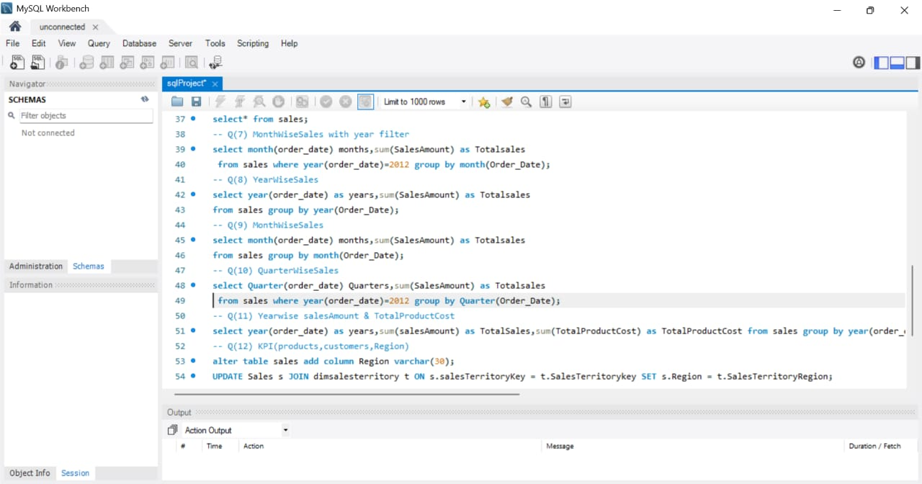
SQL Queries:

Slide 11
CONCLUSION: The Adventure Works Cycle project provided valuable insights into sales performance through comprehensive data analysis and visualization. Key tasks included data preparation, trend analysis using pivot tables, and the creation of dashboards in Excel, Tableau, and Power BI. SQL queries further enriched the analysis by breaking down sales across time periods. This project highlights actionable insights to optimize business strategies and improve decision-making.

Slide 12
THANKYOU

